Slide 1
Understanding and Supporting Early Language and Literacy development of Young Dual/English Language Learners
Linda M Espinosa, Ph.D.
espinosal@missouri.edu
GEEARS Early Education Roundtable
March 11, 2015
1

Slide 2
Definition of Dual Language Learners (DLLs)
Dual language learners are young children learning two or more languages at the same time, as well as those learning a second language while continuing to develop their first (or home) language.
Includes simultaneous
and sequential/successive
K-12 term is EL/ELL; Georgia
uses English Learners (EL)

Slide 3
WE ARE MORE DIVERSE THAN EVER!

Slide 4
Demographic Urgency
Diverse group that is growing—in size and diversity of backgrounds…
More than 30% of children enrolled in Head Start live in households where English is not the primary language (ACF, 2013)
15% of K-12 Enrollment in U.S (2011, NCES); 27% of all children in U.S. born in DL homes; most speak Spanish
Georgia, 70, 000 in 2002; 83,000 in 2012 K-12 ELLs; 300% increase from 1994-5 to 2004-5

Slide 5
Who are English/dual language learners and what do we know about their development and achievement?
Developmental Paradoxes!!

Slide 6
Children from Low-income and Dual Language Families Highly Vulnerable to Underachievement
NAEP Scores
State Achievement Data
K Entry Data
High School Completion
College Enrollment

Slide 7
Average NAEP Reading Scores for ELLs 1998-2011
2011: Average score for all 4th grade students, 221
Non ELL, 225
Basic = 208
Proficient = 238
Low poverty= 238
High poverty= 203
7

Slide 8
Need to implement coherent, consistent approaches and strengthened practices PreK-12 that reflect the current research on bilingual development and the realities of Georgia
8

Slide 9
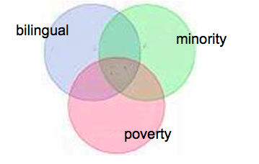
How Much of Achievement Gap is Due to Language Status (DLL) vs Poverty vs Cultural/Linguistic Discontinuity???
9
9
9

Slide 10
Having a second language is sometimes linked to higher achievement in English…ECLS-K data analysis.
Espinosa, et al., 2007
10

Slide 11
DLLs and Achievement Gap
Not all DLL children same:
Family SES, language spoken at home, country of origin related to different achievement patterns
DLLs from Asian and European home languages perform as well or better than EOs, K-3
ALL DLLs: .4 SD < EO in literacy at K entry
Spanish DLLs: .8 SD < EO at K entry; .7 < at end of 3rd grade
When SES controlled, ach. looks similar
3/7/15
11

Slide 12
“The combination of living in poverty and having limited access to early education increases the vulnerability of young DLLs to negative outcomes.”
Castro, Espinosa, & Paez, (2011)
Having more than one language during ECE years should not be considered a risk factor !!

Slide 13
The Road to School and Life Success for Dual Language Learners Begins with Knowledge about their Development

Slide 14
Synthesis of recent science for young DLLs:
1.
http://cecerdll.fpg.unc.edu/
Products:
12 Research briefs
6 Critical reviews of the literature
3 Policy reports/policy briefs
2 Working papers
1 Special Edition of ECRQ with 6 CECER-DLL articles, Fall 2014
3 SDA (ECLS-B)
14
14

Slide 16
2. California’s Best Practices for Young Dual Language Learners: http://www.cde.ca.gov/re/di/or/cdd.as
6 research overview papers by national scholars
summarized and synthesized into set of Preschool Program Practice Guidelines, Fall 2014
Training Materials and Videotapes Available March, 2015

Slide 17
Dual Language Learners Develop within Specific Contexts

Slide 18
Dual Language Learners are Very Diverse
Context Matters!
SES
Country of origin
Languages spoken
Age of exposure
Quantity and quality of language inputs
Opportunities to use language
18

Slide 19
Societal Contexts: From Vulnerabilities to Assets
DLLs have…
lower infant mortality rates
fewer physical and mental health problems
strong social skills
live in intact families with a strong work ethic
parents high ed aspirations
families support ECE experiences
These are ASSETS to ECE settings!
Garcia, E. E., Espinosa, L., Genesee, F., Gillanders, C., et al (under review). Conceptual framework for the study of young dual language learners’ development.

Slide 20
Beliefs and Attitudes Matter!!!
What we believe shapes our behaviour…..particularly on this topic (August & Shanahan, 2008)
Inaccurate myths about dual language learning lead to impoverished learning environments for children
Espinosa, 2013

Slide 21
What do we know about promoting development and improving achievement for young dual/English language learners?

Slide 22
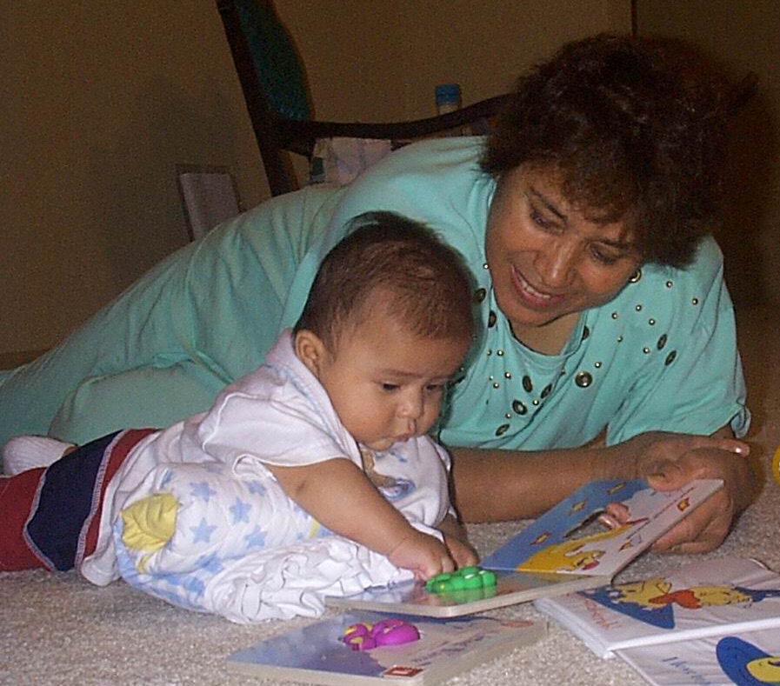
Language, Any Language, is the Foundation for Literacy…….and Literacy in English is Critical for School Success
22

Slide 23
Research for Young DLLs
Recent Area of Concern: Accountability, Demographics, Impact of Preschool
Dozens of studies---at best
Measurement and Definitional Issues
Debate on Goals & Terms
Exciting New Infant Research
Most reach similar conclusions

Slide 24
Strong Reading Skills (in English) are Essential for Academic Success in U.S.!!! How do we accomplish this goal when children already have a language that is not English?
24

Slide 25
The Science of Early Bilingualism
1. Human Capacity
2. Benefits/Differences: Cognitive, Social,
Linguistic, Executive
Function Skills, Family Dynamics, Vocabulary
3. Need to Support Both Languages
4. Families are Critical Partners
3/7/15
25

Slide 26
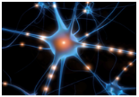
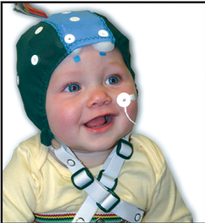
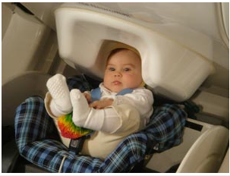
Infant Brains & Bilingualism: Study Methods
26

Slide 27
Research Base
Brain development of young bilinguals:
Different than monolinguals
Two linguistic systems develop
At birth, can perceive all phonemes in all languages; by 10-12 months phonemic pruning has occurred

Slide 28
Notes:
P kuhl’s ILABS graph

Slide 29
Cognitive Development*
Young bilinguals show advanced skills in non-verbal executive control skills….detectable at 7 months!
inhibitory control (ability to resist a habitual response or information not relevant)
working memory or updating (ability to hold information in mind and mentally manipulate it)
cognitive flexibility ability to adjust to changes in demands or priorities and switch between goals
* Barac, R., Bialystok, E., Castro, D. C., & Sanchez, M. (2014). The Cognitive Development of Young Dual Language Learners: A Critical Review. Early Childhood Research Quarterly, 29 (4), 699-714.

Slide 30
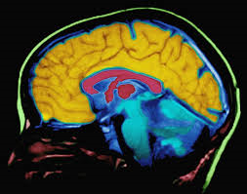
Language and Literacy Development of DLLs*
Timing: age of exposure
Social and statistical
Amount and quality of
exposure
Opportunity to Use and
Practice
* Hammer, C. S., Hoff, E., Uchikoshi, Y., Gillanders, C. & Castro, D. C. (2014). The Language and Literacy Development of Young Dual Language Learners: A Critical Review. Early Childhood Research Quarterly, 29 (4), 715-733.

Slide 31
Language and Literacy Development of DLLs..
Vocabulary development looks different: longer lexical retrieval time
Smaller vocabularies in each language; conceptual vocabularies when combined in 2 languages comparable
Speech production somewhat slower
Grammatical development differed
Cross-language (L1-L2) influences varied by similarities of 2 languages
31

Slide 32
Social Emotional Development of DLLs*
Children of Mexican immigrant families tended to have more social-emotional competencies (initiative and self-control) and fewer behavior problems than nonimmigrants at K entry.
* Halle, T., Whittaker, J. V., Zepeda, M., Rothenberg, L., Anderson, R., et al (2014). The Social-­‐Emotional Development of Dual Language Learners: Looking Back at Existing Research and Moving Forward with Purpose. Early Childhood Research Quarterly, 29 (4), 734-749.

Slide 33
Bilingual Advantages Tied to Extent of Bilingualism
Balanced bilingualism necessary for cognitive, linguistic benefits
Bilingual advantages found across cultural and SES groups

Slide 34
Language Exposure and Opportunity to Use Best Predictors of Proficiency
Children need opportunities to hear, process, and use language during meaningful interactions
Research suggests young children need at least 25-30% of time in language to learn it
34

Slide 35
Knowledge Base for Young DLLs: Consensus
Babies have capacity for learning multiple languages from first year. Linguistic geniuses
Balanced early bilingualism is possible with sufficient high quality input in both.
Cognitive, linguistic, social, family, economic advantages to bilingualism
First language vulnerable to attrition
Proficiency in the first language is linked to English acquisition

Slide 36
EARLY CARE AND EDUCATION CONTEXTS
Child care appears to be especially beneficial for DLLs: larger gains than other children
^{in center-based care}
^{in high quality care}
when home language is spoken in setting
Evidence suggests DLLs are less likely to
^{be in child care before Pre-K}
be enrolled in center-based care before Pre-K experience high quality care or use home language in center care
Espinosa, L. M., Burchinal, M., Winsler, A., Tien, H., Castro, D. C., & Peisner- Feinberg, E. (under review). Child Care Experiences among Dual Language Learners in the US: Analyses of the Early Childhood Longitudinal Survey-Birth

Slide 37
Importance of Supporting Both Languages
Frequently early English exposure leads to loss of home language
Carefully balanced language approach is needed during early years
Learning English is important, but should not come at the expense of continued development in first language

Slide 38
Consequences of Home Language Loss
Possible disruption of family dynamics
Lily Wong Fillmore’s work with immigrant families in California
Lost bilingual advantages
Rising evidence of negative long term consequences on child and maternal health of early language loss and acculturation

Slide 39
What does this mean?
The young bilingual brain processes language differently from monolingual children which influences specific aspects of cognitive and linguistic development.
Initial differences may look like delays, DLLs need time and language learning opportunities to become proficient in both languages
Bilinguals cannot be compared to monolingual norms when assessing children
Need: Specific strategies for teachers that promote oral language development in English (ELD) and help DLLs extend and apply L1 knowledge
39

Slide 40
Challenge: How do we support home language development and promote English language development with multiple languages of children/families, monolingual teachers, different educational contexts?
3/7/15
40

Slide 41
Program Approaches, Interaction and Instructional Strategies that Promote Improved Development and Achievement for DLLs
First--- Warm, Responsive, Enriched Interactions and Good Instructional Practices Help Dual Language Learners (but are not sufficient)
Goldenberg, et al., 2013

Slide 42
How to Support Home Language While Promoting English Language Development
Set of Strategies that Bridge between home language (L1) and English:
Cognate charts
Front-loading vocabulary in home language
Each language linked but distinguished (voice, character, color)
Labeling in both home language and English
Match instruction to child’s ELD level
Partnering with Families!!
From Espinosa (2015), Chapter 4

Slide 43
ALL ECE Practitioners Can Support ALL Languages
If possible, hire qualified bilingual teachers, family liaisons, and assessors
For monolingual, English speaking teachers there are many strategies to provide rich learning opportunities in each language
Bring home language into setting (family, volunteers, community reps.), authentic bilingual materials, music, CDs, activities

Slide 44
Language approaches need to be Intentional, Systematic, and Carefully Reviewed
Plan for use of each language, who, when, and how: Language policy and language model
Haphazard approach does not work
Celebrate emerging bilingual abilities of children---linguistic assets for child, family, and society
44
44

Slide 45
Resources
California Department of Education (2013). California’s Best Practices for Young Dual Language Learners: Research Overview Papers. http://www.cde.ca.gov/sp/cd/ce/documents/dllresearchpapers.pdf
California Department of Education (2013) video resource on Dual-Language Development
https://www.youtube.com/watch?v=ly4dUetmz78
This video addresses “Dual-Language Program Models and Strategies,” “Development of the Home Language and of English,” “Observation and Assessment of Young Dual-Language Learners,” and “Relationships with Families of Dual-Language Learners.”

Slide 46
^{More Resources}
Office of Head Start: Early Childhood Learning & Knowledge Center:
^{http://eclkc.ohs.acf.hhs.gov}
* The National Center on Cultural and Linguistic Responsiveness provides the Head Start community with research-based information, practices, and strategies to ensure optimal academic and social progress for linguistically and culturally diverse children and their families.

Slide 47
Conclusion
While all ECE teachers cannot instruct in all languages, all teachers can support all languages by working with families and using specific strategies that bring home language and culture into ECE settings.
3/7/15

