Slide 1
Garnering Effective Outreach and Research in Georgia for Impact Alliance

Slide 2
Goal:
To understand factors that contribute to the COVID-19 in communities and establish effective, community-engaged outreach and response strategies

Slide 3
Garnering Effective Outreach and Research in Georgia for Impact Alliance
Phone: 404-752-1700
georgiaceal@msm.edu

Slide 4
GEORGIA CEAL Priorities
Establish the Georgia CEAL as a statewide community engagement hub for COVID-19 response and recovery and future public health emergencies
Identify areas to share COVID-19 educational materials, messages and vaccine uptake interventions
Identify beliefs around COVID-19 and the vaccines
To develop and disseminate sensitive, scientifically based information COVID 19 vaccine information toward vaccine readiness and participation
https://covid19community.nih.gov/
Notes:
AIM 1

Slide 5
National COVID Resilience Resilience Network
ncrn@msm.edu
www.msm.edu/ncrn

Slide 7
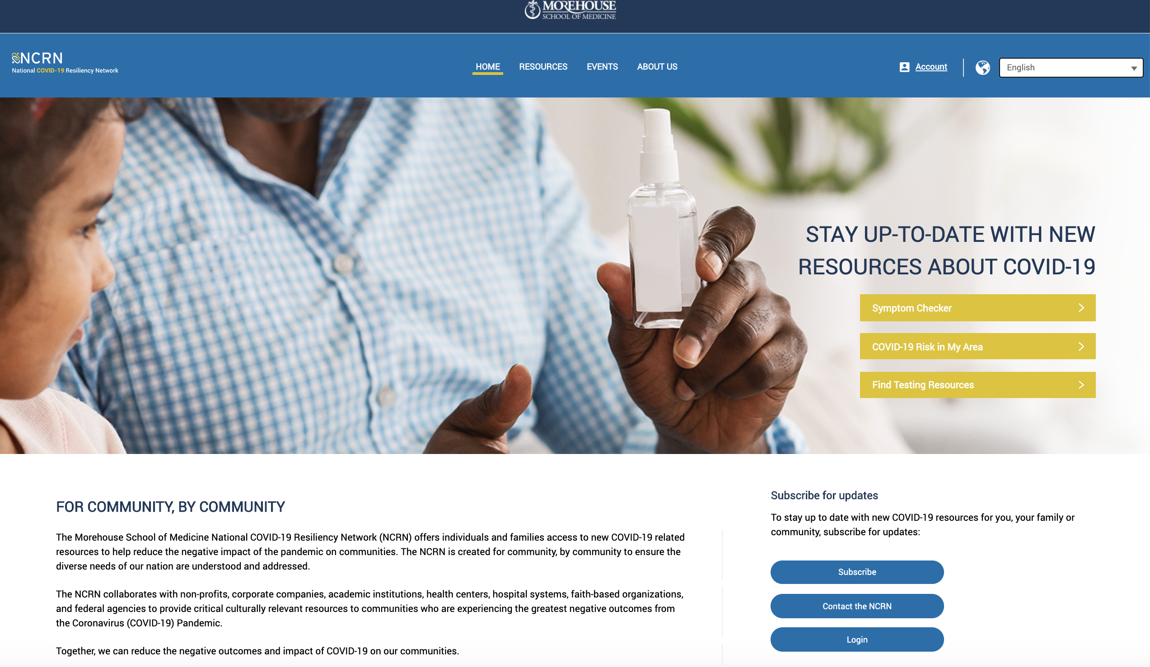
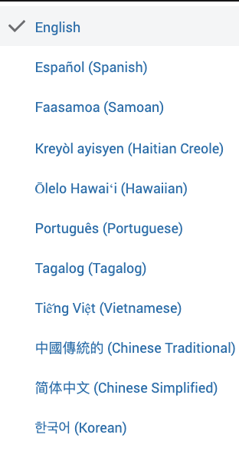
Language Selector &
Symptom Checker
Notes:
Symptom Checker

Slide 8
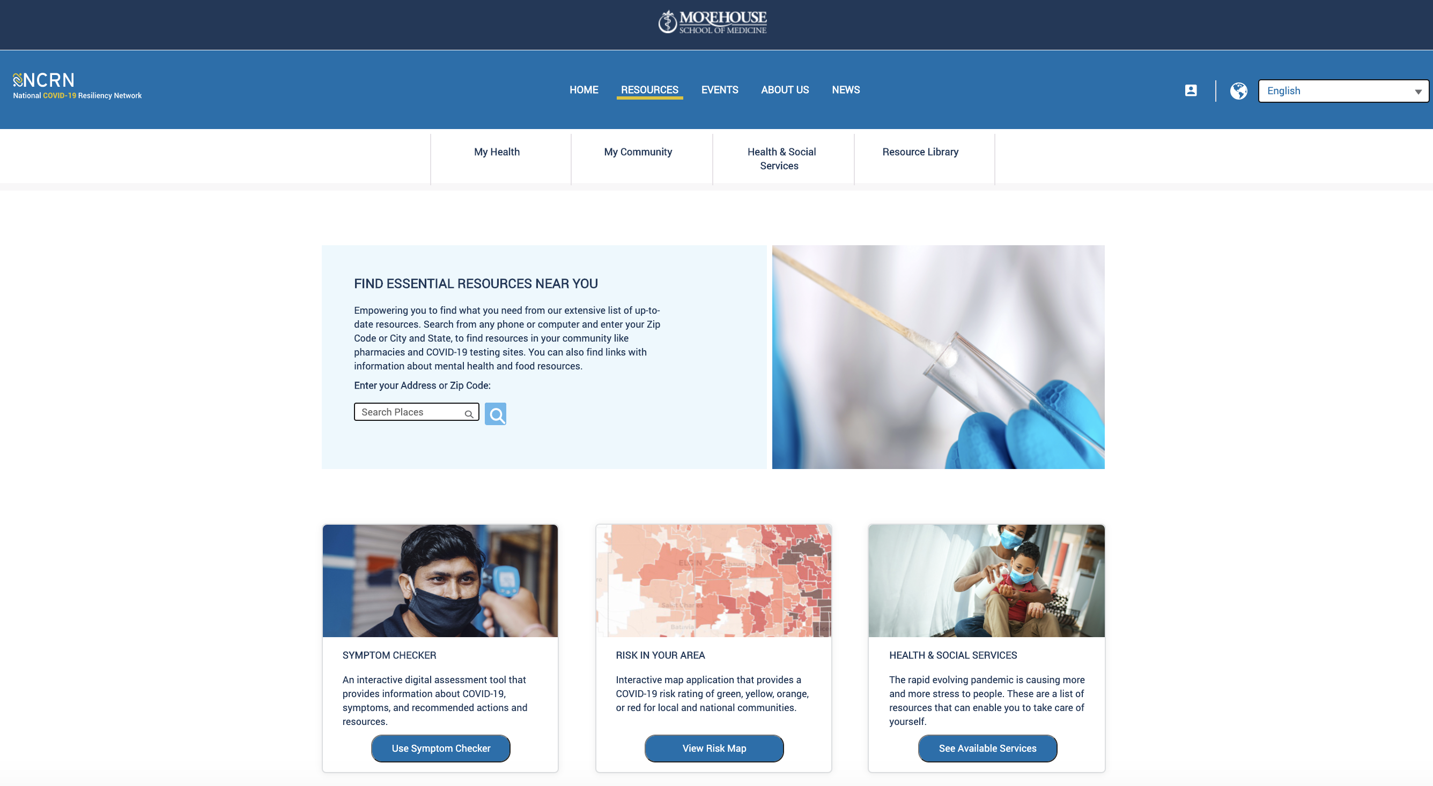
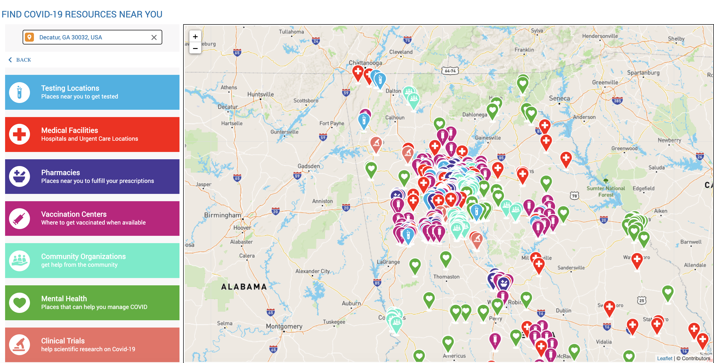
Location-Based Resource Navigator

Slide 9
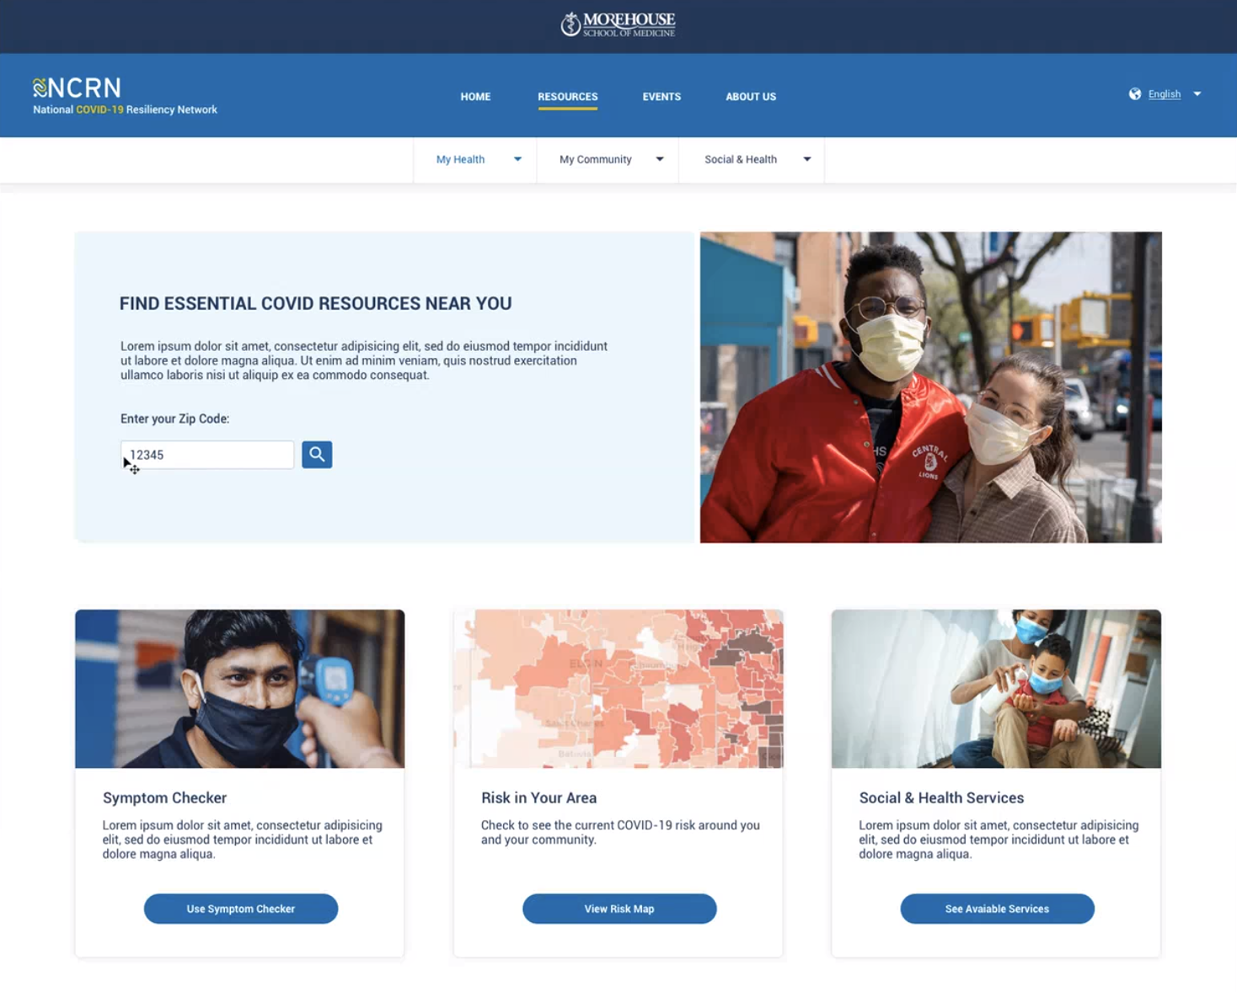
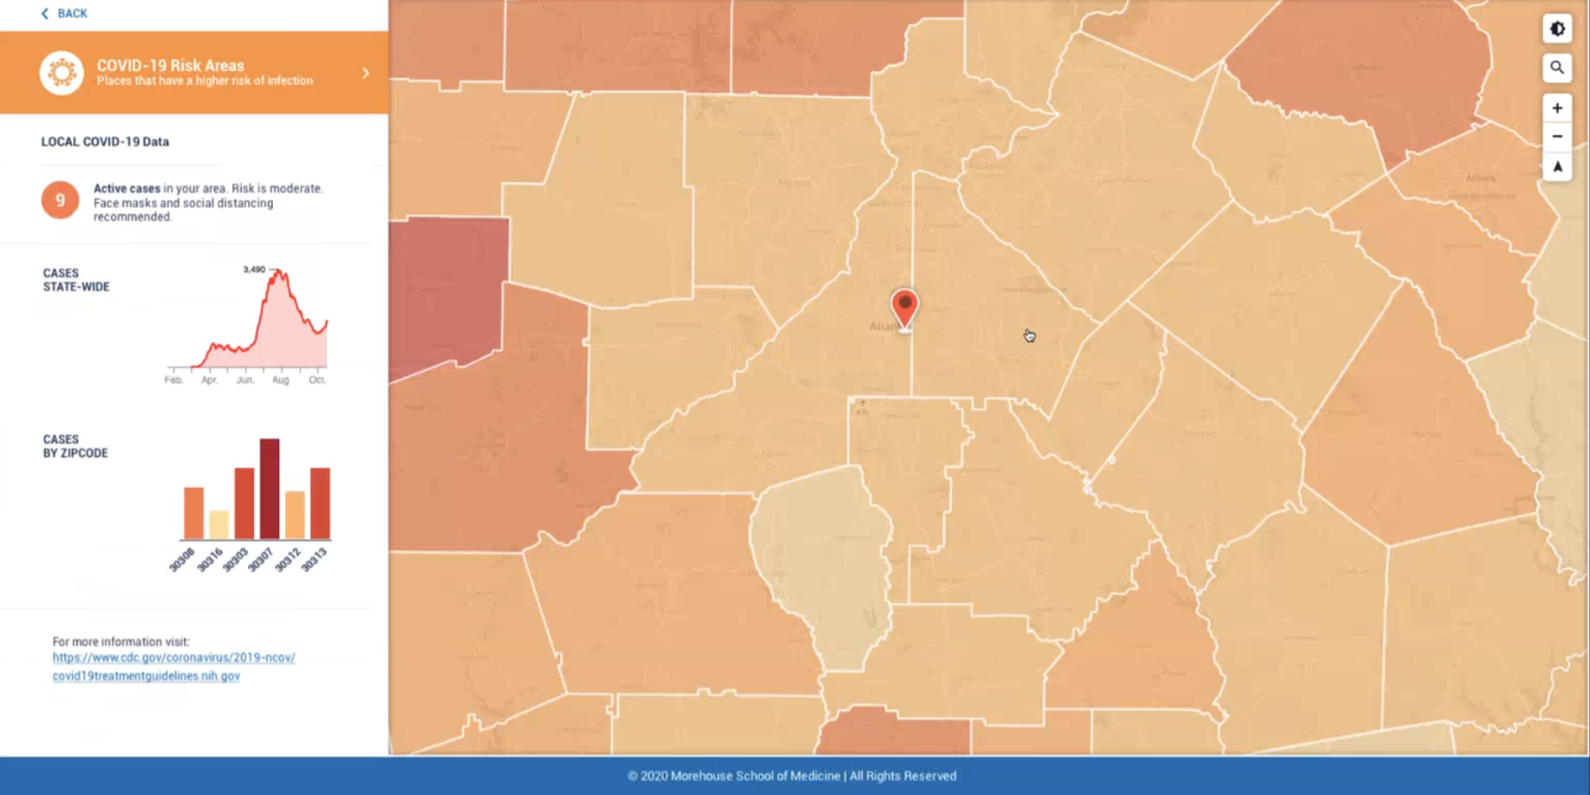
Location-Based Risk Assessment

Slide 10
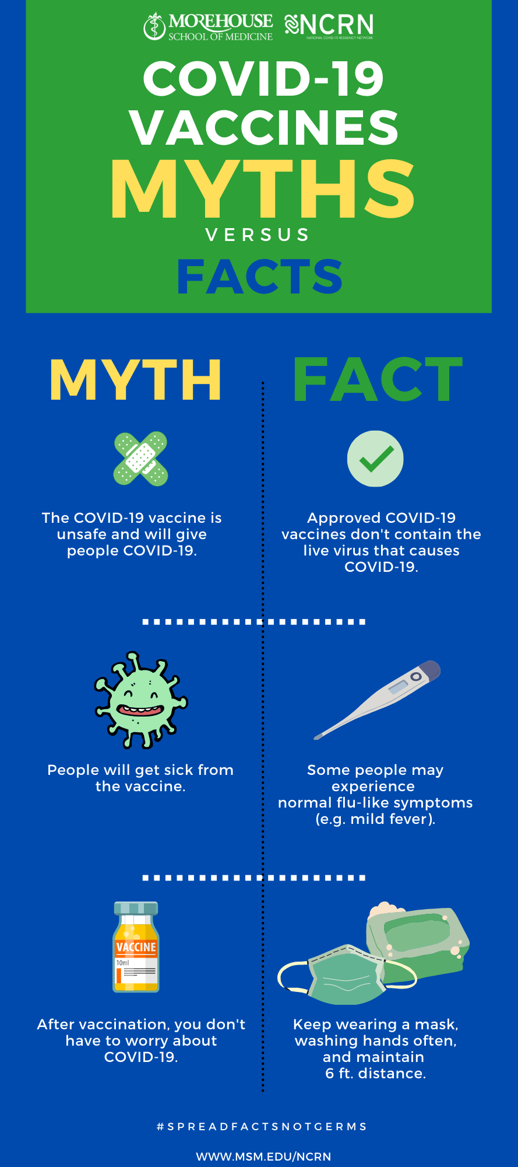
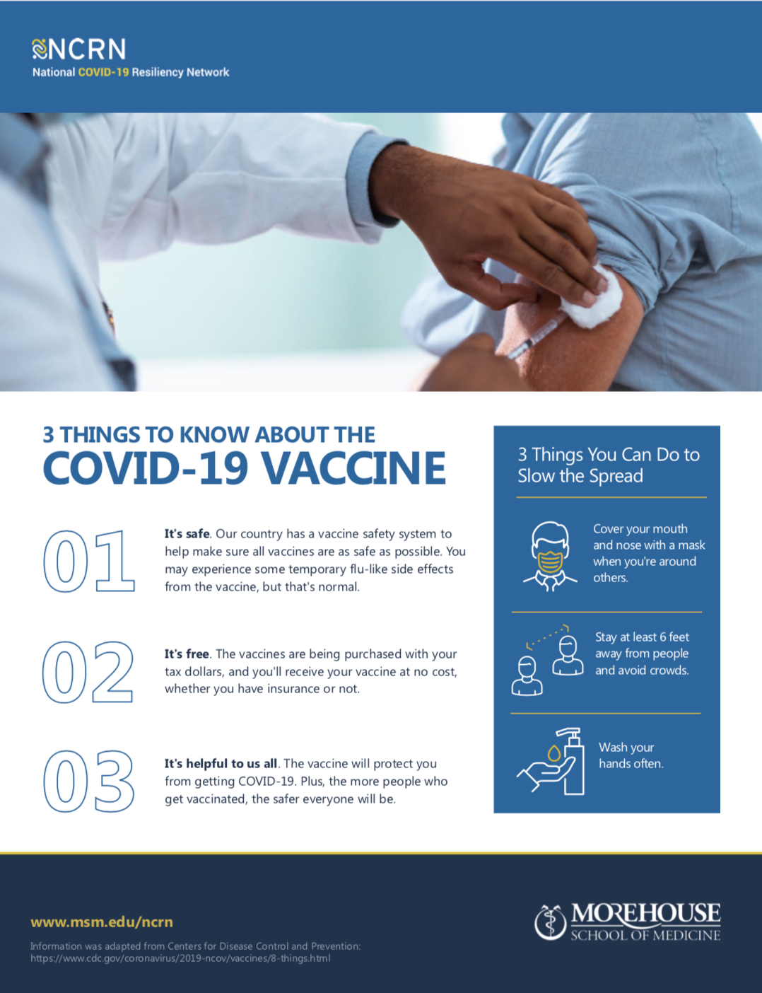
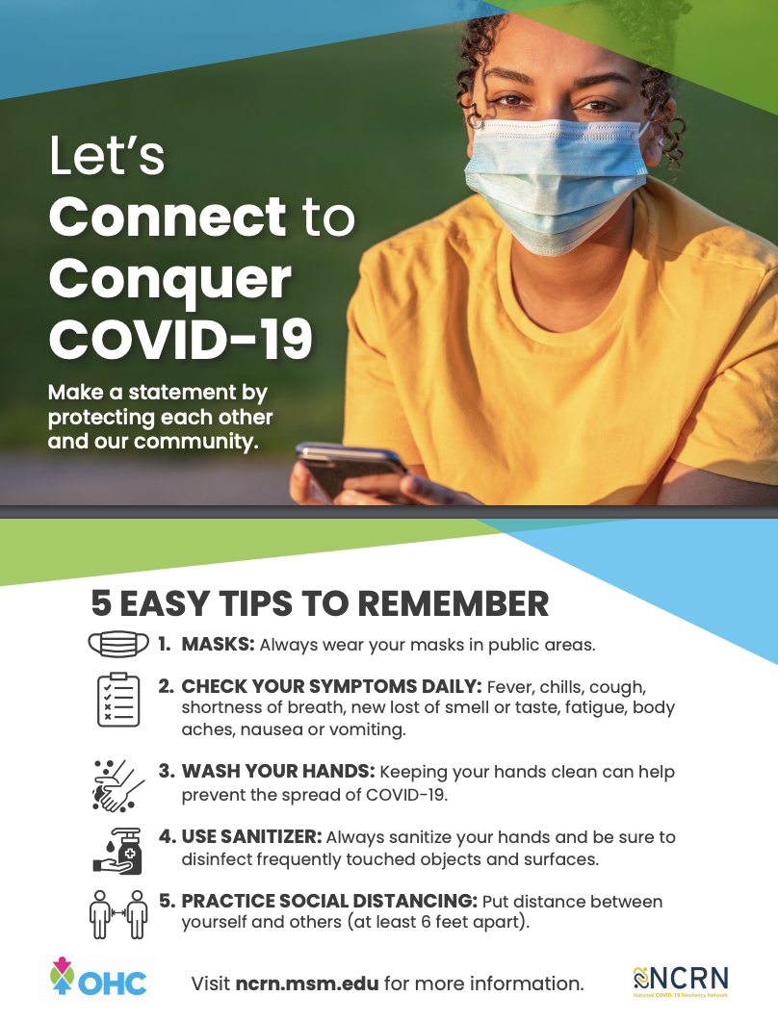
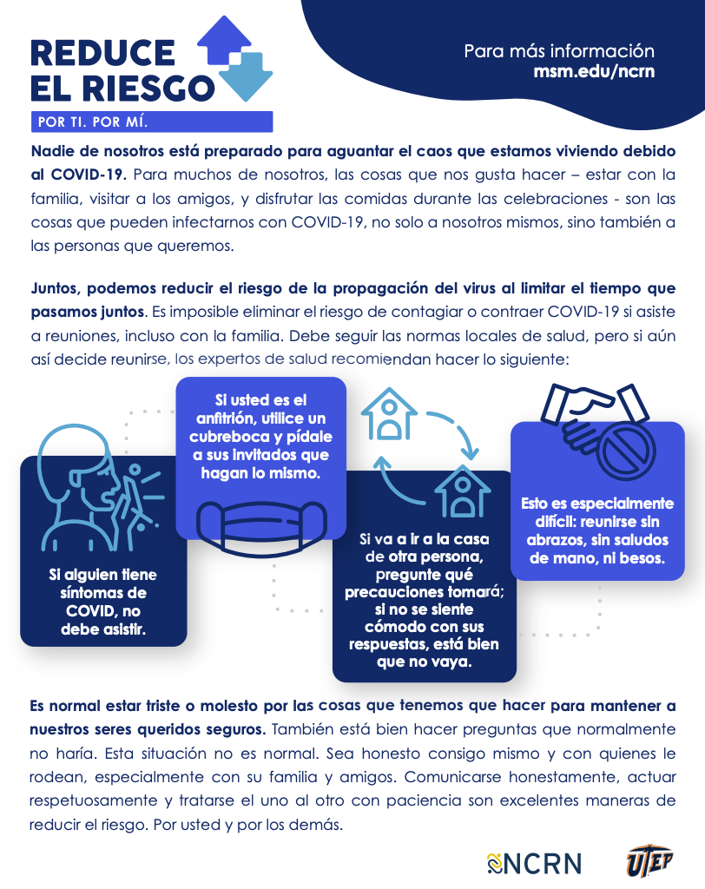
Educational Materials Library
Notes:
Resource Library

Slide 11
Multilingual
Call Center
1-877-904-5097
9am-9pm EST
Notes:
Resource Library

Slide 12
Garnering Effective Outreach and Research in Georgia for Impact Alliance
Phone: 404-752-1700
georgiaceal@msm.edu

